Slide 1
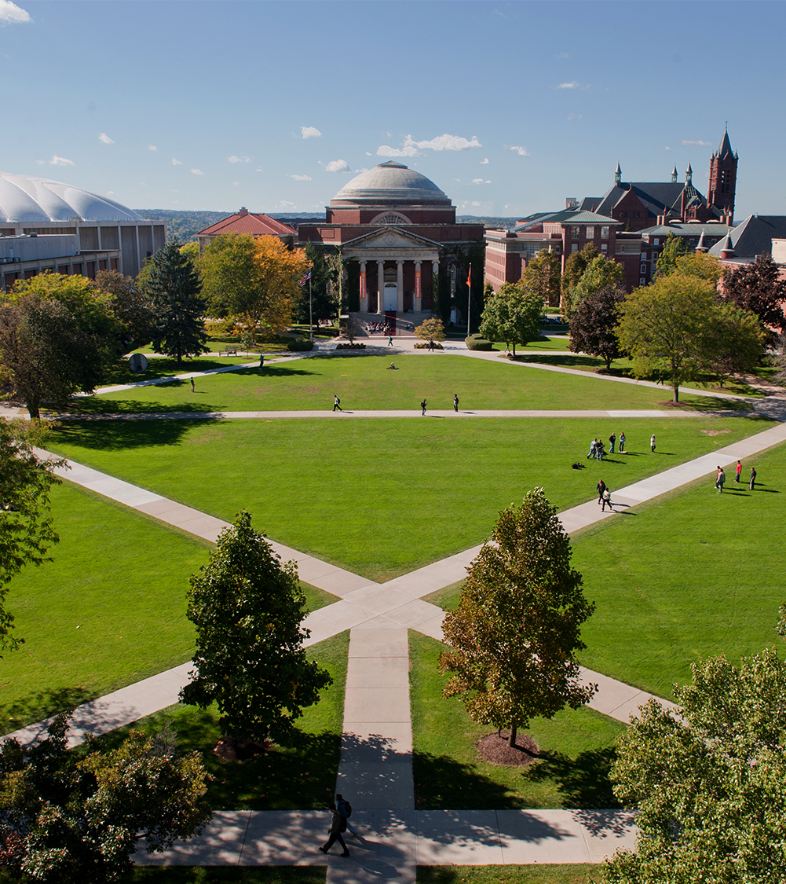
Applied Data Science Portfolio Milestone
School of Information Sciences
Darrell L. Nelson II
October 09, 2019
M.S. in Applied Data Science

Slide 2
Outline
About Me
Professional Experience
Motivation
Learning Objectives
Next Steps
Wrap Up

Slide 3

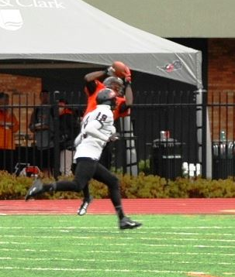

About Me
Born and raised in Los Angeles, California
Collegiate Athlete
Football
Rugby (Club)
Lifelong Mentor & Tutor
Boys & Girls Club
Mentor Collective
Freelance
Passion for Chemistry

Slide 4
Professional Experience
Lewis & Clark College (‘11 – ‘14)
B.A. in Chemistry
Washington University in St. Louis (‘14 – ‘16)
B.S. in Chemical Engineering
Applied Materials (Process Support Engineer)
Oversaw development life cycle of five generations of 3D NAND flash memory for Micron
Quantified accuracy, precision, and repeatability of experimental data/measurements through DOEs on statistical software (JMP)
Key Achievement: Integral factor in winning contracts for >$20M in the space of two years

Slide 5
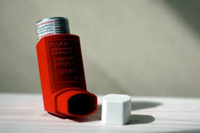
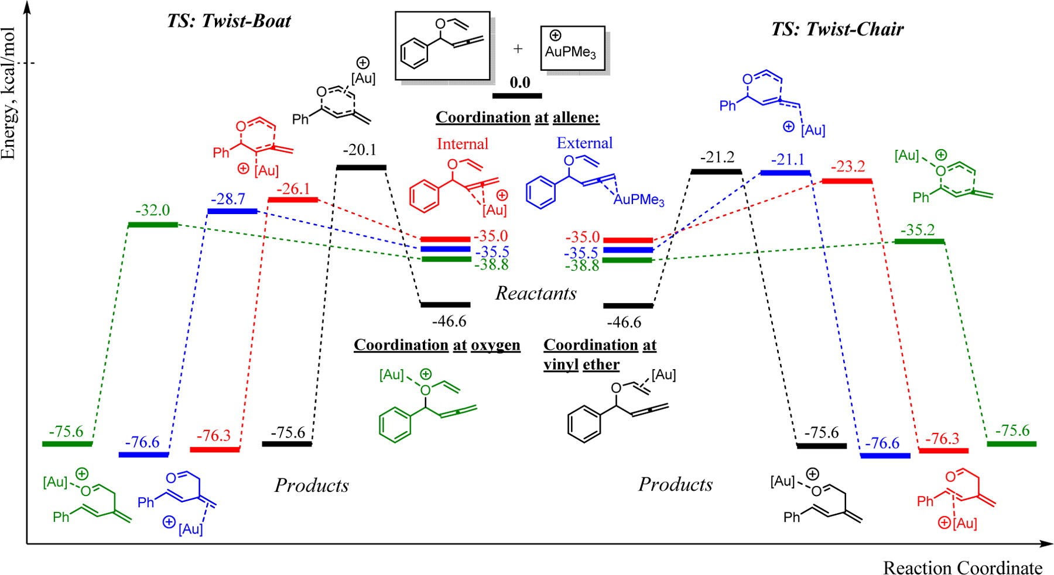
Motivation
Develop catalysts to remove pollutants from the air
Understand reaction mechanisms
Experimental & Computational Investigation of the Synthesis of 1,3-Dienes by Au-Catalyzed Claisen Rearrangements of Allenyl Vinyl Ethers
Use ML to predict the outcomes of reactants
Machine Learning Approaches to Design Catalysts for C1 Chemistry
Industry acceptance of Data Science

Slide 6

Learning Objectives
This report will go through all 7 learning objectives and provide detailed examples of how the objectives were met by providing a brief synopsis of three projects.

Slide 7
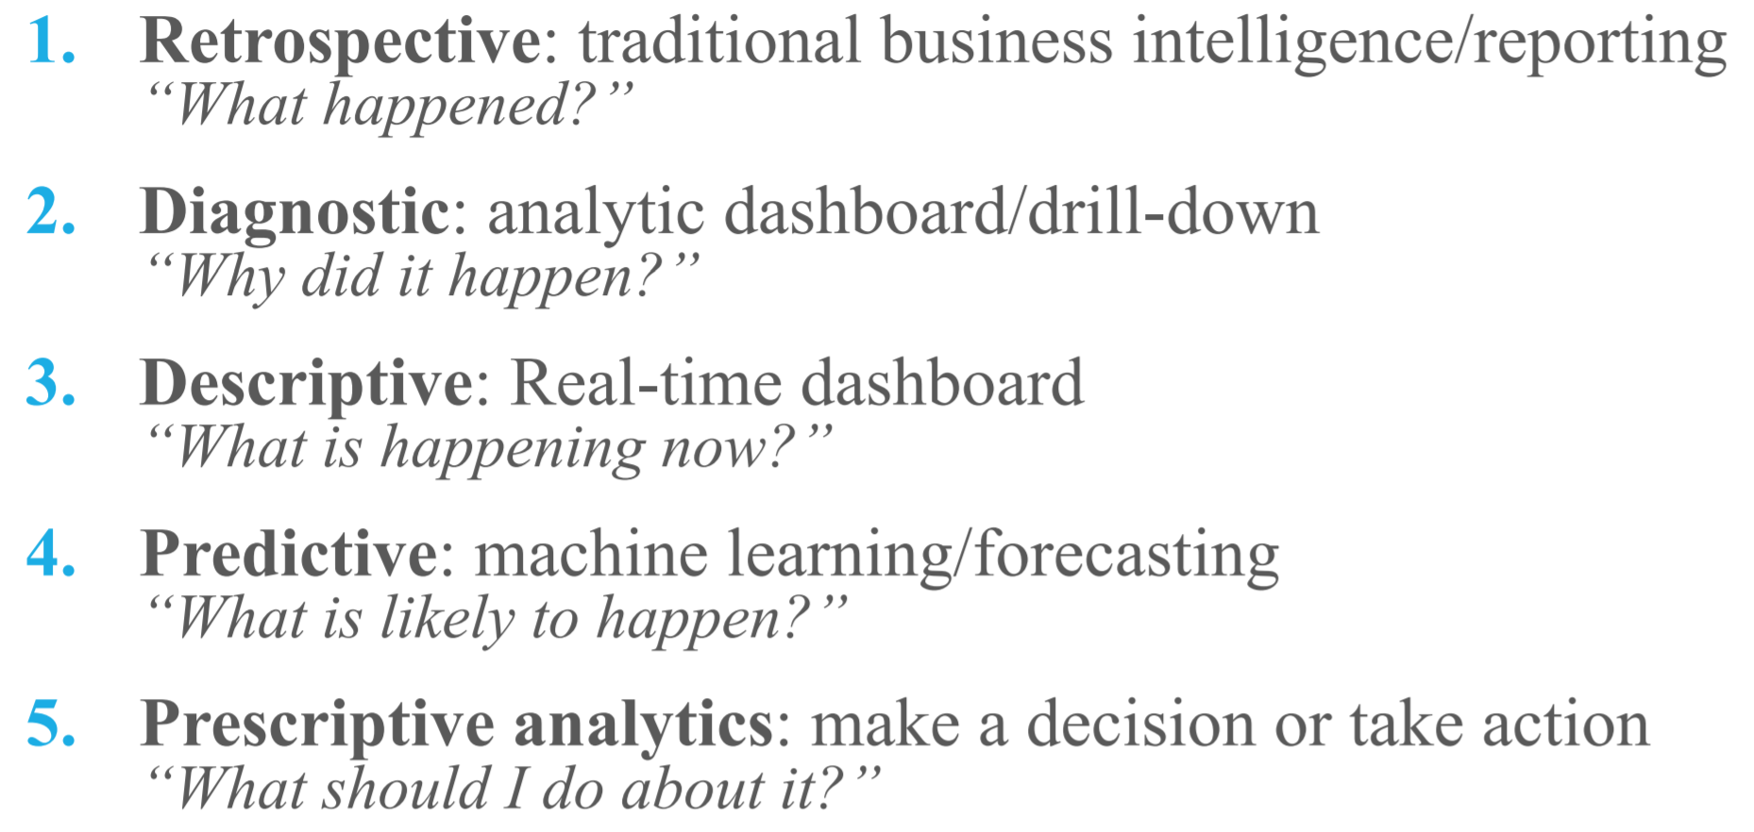
Learning Objective # 1
Describe a broad overview of the major practice areas of data science.
Picture taken from IST – 722 Asynch Week 01

Slide 8
Learning Objective # 1
Describe a broad overview of the major practice areas of data science.
Data Science:
Descriptive Analytics
Dashboards with elementary statistics (e.g. mean, std dev, quartiles…)
Predictive Analytics
Future trends: forecasting, predicting values of missing fields (supervised learning), classifying unlabeled data (unsupervised learning), and probable impact of data changes on future trends (semi-supervised learning)
Prescriptive Analytics
Showcases (acts on) viable solutions and assess the impact of that choice on future trends

Slide 9
Learning Objective # 1
Describe a broad overview of the major practice areas of data science.
IST – 718 (Big Data Analytics)
Python IDE (Jupyter)
Predict Super Bowl winner based on statistics
Over 30 offensive/defensive metrics for all NFL teams over 9 years
Key Areas:
Data Mining & Statistical Analysis
Gathering, Cleaning, and Transforming Data
Supervised Learning (ML)
Data Visualization
Presenting Results

Slide 10
Learning Objective # 2
Collect and organize data
IST – 652 (Scripting for Analytics)
Python IDE (Syder)
Over 3,000 tweets were scraped and analyzed from Twitter using Tweepy
Study correlation between a school’s Twitter account and recruiting & pre-season rankings
Tweets, Retweets, Likes, Retweet/Tweet, & Likes/Tweet
Created displacement metric rank features

Slide 11
Learning Objective # 2
Collect and organize data
Retweet per tweet is the best feature to predict recruiting and pre-season rankings
Strongly recommend teams to invest in building up their social media imprint to attract more recruits

Slide 12
Learning Objective # 3
Identify patterns in data via visualization, statistical analysis, and data mining
MAR – 653 (Marketing Analytics)
Tableau (W.E.) and R (IST – 687 & IST – 707)
World Happiness Report from 2015 – 2017
Marketing Firm:
Recommend the happiest countries that are popular routes/destinations for the travel and tourism
What are the top 3 attributes for country-wide happiness?
How is happiness trending in countries and continents

Slide 13
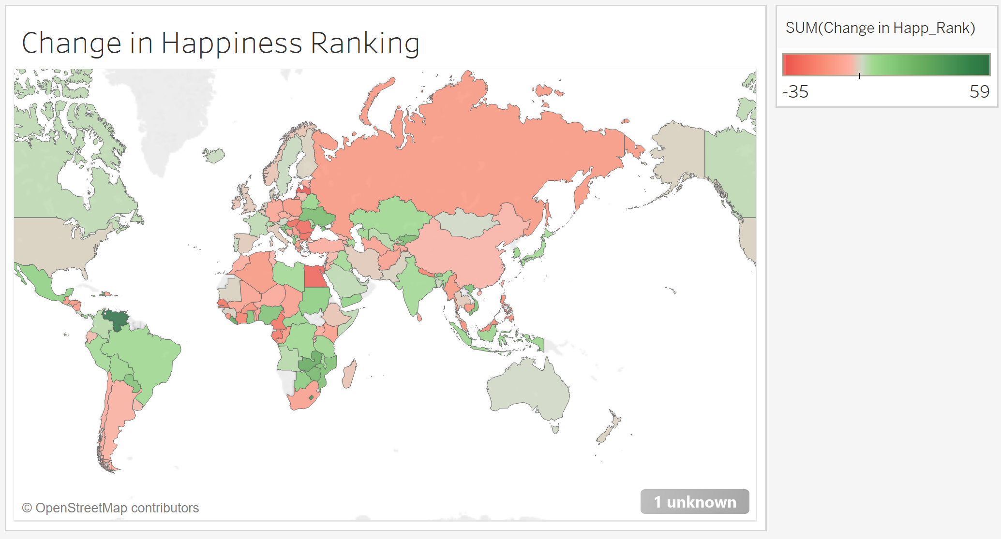
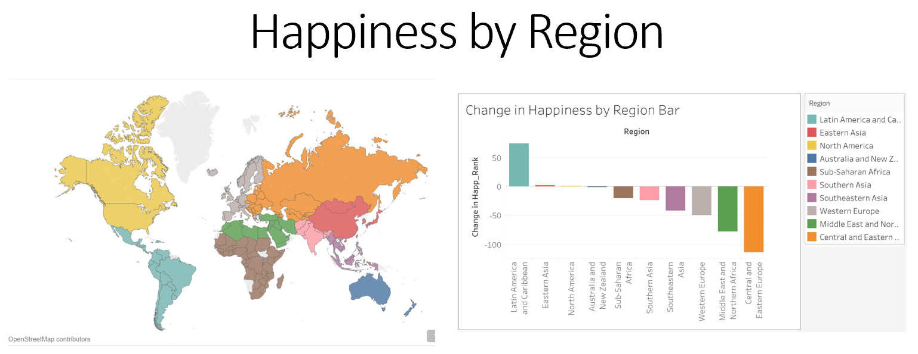
Learning Objective # 3
Identify patterns in data via visualization, statistical analysis, and data mining
Used XLStat, Excel, and R to run k-means, Neural Network, and Random Forest Models
Family, Health, and Economy are the most important features to happiness

Slide 14
Learning Objective # 4
Develop alternative strategies based on the data
IST – 718 (Big Data Analytics)
Python IDE (Jupyter)
Over 30 offensive/defensive metrics for all NFL teams over 9 years
Predict Super Bowl winner based on statistics
Initial results were horrendous
Predictions skewed toward biased class (non-playoff team)

Slide 15
Learning Objective # 4
Develop alternative strategies based on the data
Issue:
Teams could not be classified in any class
There must be limitations!!
Action:
Developed a constraint on # of teams in a class & a for loop that iterated through the teams and selected the most probable class only if it was available
Result:
19 of 20 non-playoff teams were correctly classified.
Missed classes were never more than +/- 1 round off (except NE)

Slide 16
Learning Objective # 5
Develop a plan of action to implement the business decisions derived from the analyses
All Projects have met this requirement
IST – 652 (Scripting for Analytics)
Python IDE (Syder)
Over 3,000 tweets were scraped and analyzed from Twitter using Tweepy
Studying correlation between a school’s Twitter account and recruiting & pre-season rankings
Tweets, Retweets, Likes, Retweet/Tweet, & Likes/Tweet
Created displacement metric rank features

Slide 17

Learning Objective # 5
Develop a plan of action to implement the business decisions derived from the analyses
Build up school’s social media infrastructure and hire undergraduates who could better relate to incoming freshmen
PoA: increase social media buzz to affect the number/quality of recruits received

Slide 18
Learning Objective # 6
Demonstrate communication skills regarding data and its analysis for managers, IT professionals, programmers, statisticians, and other relevant professionals in their organization
All Projects have met this requirement
MAR – 653 (Marketing Analytics)
Tableau (W.E.) and R (IST – 687 & IST – 707)
World Happiness Report from 2015 – 2017
Marketing Firm:
Recommend the happiest countries that are popular routes/destinations for travel and tourism
What are the top 3 attributes for country-wide happiness?
How is happiness trending in countries and continents

Slide 19
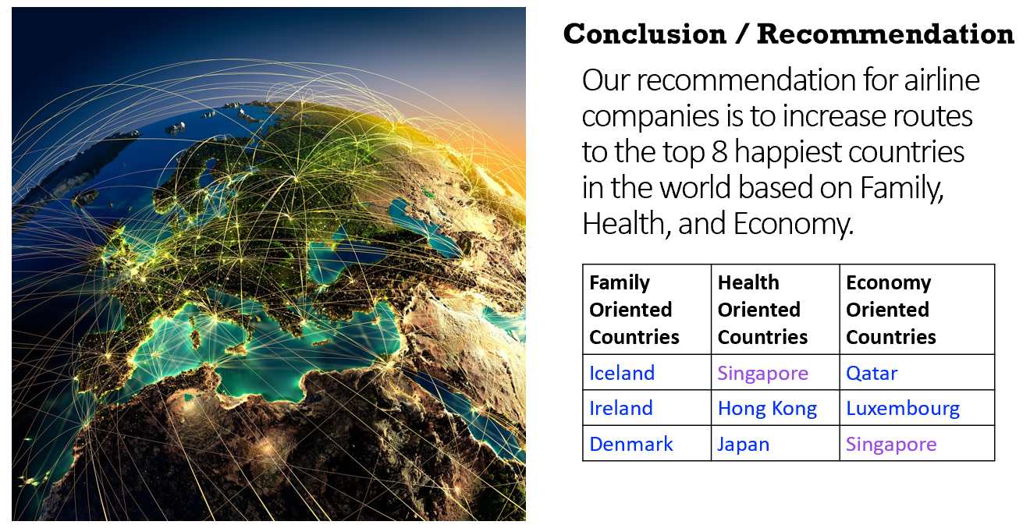
Learning Objective # 6
Demonstrate communication skills
Countries rated highest in established key attributes were recommended to airline companies
Airline campaign centered around experiencing the happiest places on Earth

Slide 20
Learning Objective # 7
Synthesize the ethical dimensions of data science practice
Less exposure in previous courses
Currently taking IST – 618 (Information Policy)
IST – 652 (Scripting for Analytics)
PoA: increase social media buzz to affect the number/quality of recruits received
Is manipulating kids to go to a particular school ethical?
Is this behavioral mapping and control?

Slide 21
Next Steps

Slide 22
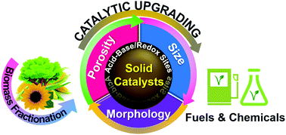
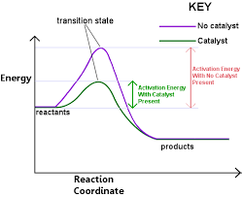
Next Steps
Couple my background in experimental and computational chemistry with Machine Learning to develop novel catalysts
Become an expert in catalyst innovation via ML techniques

Slide 23
Wrap Up

Slide 24
Wrap Up
M.S. in Applied Data Science has been a challenging and rewarding experience
Provided the necessary steps for my future
Would highly recommend
Thank you so much!

Slide 25
Thank you!

